Slide 1
Chapter 1: An Overview of the Global Economy
“Think not forever of yourselves, O Chiefs, nor of your own generation. Think of continuing generations of our families, think of our grandchildren and of those yet unborn, whose faces are coming from beneath the ground.”
Peacemaker, founder of the Iroquois Confederacy (ca. 1000 CE)

Slide 2
See the forest, not just the trees.
Notes:
See the forest, not just the trees! See the big picture, as well as information. Photo Denise Ames, north of Santa Fe, New Mexico, October.

Slide 3
The Global Wave
Integration
Global Capitalism
Environmental Pressures
Decline Nation States
English Language
Consumer Culture
Democracy
Human Rights
Population Growth
Globalized Conflict
Social Inequality
Technological Marvels
Identity tied to Global Citizenship
Compression of Space and Time
Recognition of Systems

Slide 4
Neoliberalism
Free market capitalism
Free trade capitalism
Market economy
Supply-side economics
Laissez-faire capitalism
Classical capitalism
Anglo-American capitalism
Corporate capitalism

Slide 5
Managed Capitalism John Maynard Keynes
Notes:
Managed capitalism, theorist Englishman John Maynard Keynes (1883-1946). Wikipedia

Slide 6
Socialism, Communism, Karl Marx
Notes:
Theorist behind socialism and communism, Karl Marx (1818-1883). Wikipedia

Slide 7
State Capitalism, in China
Notes:
Bank of China headquarters in Beijing, China. Founded in 1927, in 2010 it had 389,827 employees and $1.723 trillion in assets. Once 100% owned by the Chinese state, now 26% is privately owned. (Wikipedia)

Slide 8
State Capitalism Brazil
Notes:
Drilling Platform of the Brazilian Oil Company Petrobas. In 2010 it was the 4th largest company in the world measured by market capitalization. The government owns 64% of the company. Wikipedia

Slide 9
Four Ways to Accumulate Wealth
Primary Industries
Secondary Industries
Service Industries
Financialization

Slide 10
Terms and Concepts
Core and Periphery
Western and Modern
Right and Left

Slide 11
Eight Interest Groups
Government (state)
Corporations (large)
Labor
Consumers
Small Business
Farmers
Underclass (poor, disabled, unemployed)
Middle Class

Slide 12
Techno-
logical
Economic
Social
Religious
Environ-mental
Arts
Values and Attitudes
Cultural
Political
Holistic Approach

Slide 13
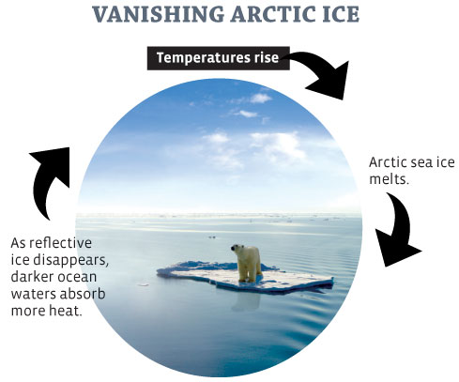
Notes:
A feedback loop. Daryl Fuller graphic

Slide 14
An Iceberg Events Episodes Patterns Worldviews Human Commonalities
Notes:
Why are the human commonalities the huge mass under the water that is unseen when looking at an iceberg? Daryl Fuller graphic

Slide 15
Contemporary Worldviews
Indigenous
Modern
Fundamentalist
Globalized
Transformative
Notes:
In the Global Wave – five worldviews.

Slide 16
Indigenous Worldview
Notes:
The !Kung, in their village in Namibia, Africa. They have survived for over 50,000 years as hungers/gatherers in the Kalahari Desert. What can you tell about their way of life from this photograph? (Wikipedia)

Slide 17
Modern Worldview
Extols scientific reasoning
Exalts individualism
Treats nature as commodity
Promotes liberal political traditions
See world as separate and fragmented
Separates church and state
Promotes industrial production
Places faith in technological solutions
Uses punishment as retribution
World a giant machine

Slide 18
Funda-mentalist Worldview
Notes:
Women in traditional dress by mosque in Iran, photo Denise Ames

Slide 19
Globalized Worldview
Notes:
McDonald’s mega Big Mac and coke in Malaysia, everything is bigger according to the globalized worldview. Wikipedia

Slide 20
Transformative Worldview
Notes:
Wind farm in UK represents the transformative worldview. Royd Moor Windfarm in the United Kingdom (UK). Wikipedia

